Slide 1

BANKNOTE AUTHENTICATION SYSTEM
Presented by Himanshu Mittal (179302059)

Slide 2

CONTENTS
1
Business Problem
2
Decision Tree classification
3
Naïve Bayes classification
4
Result
Notes:
Image source:-
https://pixabay.com/en/technology-industry-big-data-cpu-3092486/

Slide 3

01
BUISNESS PROBLEM
Notes:
Image source:-
https://pixabay.com/en/architecture-building-business-2179108/

Slide 4

PROBLEM STATEMENT
Banknotes are currencies used by any nation to carry-out financial activities and are every countries asset which every nation wants it (bank-note) to be genuine.
Lot of miscreants induces fake notes into the market which resemble exactly the original note. Hence, there is a need for an efficient authentication system which predicts accurately whether the given note is genuine or not.
Notes:
Image source:-
https://pixabay.com/en/computer-keyboard-apple-laptop-2563737/

Slide 5
02
DECISION TREE CLASSIFIER
Notes:
Image source:-
https://pixabay.com/en/architecture-building-business-2179108/

Slide 6
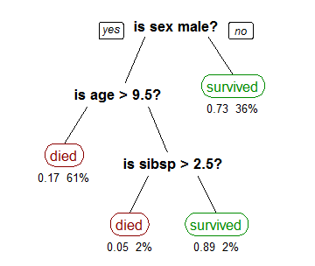
DECISION TREE CLASSIFIER
Decision tree builds regression or classification models in the form of a tree structure.
It breaks down a dataset into smaller and smaller subsets while at the same time an associated decision tree is incrementally developed
The final result is a tree with decision nodes and leaf nodes.
A decision node has two or more branches, each representing values for the attribute tested.
Leaf node represents a decision on the numerical target.
The topmost decision node in a tree which corresponds to the best predictor called root node. Decision trees can handle both categorical and numerical data.
A tree showing survival of passengers on the Titanic
Notes:
Image source:-
https://pixabay.com/en/computer-keyboard-apple-laptop-2563737/

Slide 7

TYPES OF DECISION TREE
Decision trees used in data mining are of two main types:
Classification tree analysis is when the predicted outcome is the class (discrete) to which the data belongs.
Regression tree analysis is when the predicted outcome can be considered a real number (e.g. the price of a house, or a patient's length of stay in a hospital).
A special case of a decision tree is a decision list, which is a one-sided decision tree, so that every internal node has exactly 1 leaf node and exactly 1 internal node as a child (except for the bottommost node, whose only child is a single leaf node).
While less expressive, decision lists are arguably easier to understand than general decision trees due to their added sparsity, permit non-greedy learning methods and monotonic constraints to be imposed.
Types of Decision Tree
Notes:
Image source:-
https://pixabay.com/en/computer-keyboard-apple-laptop-2563737/

Slide 8
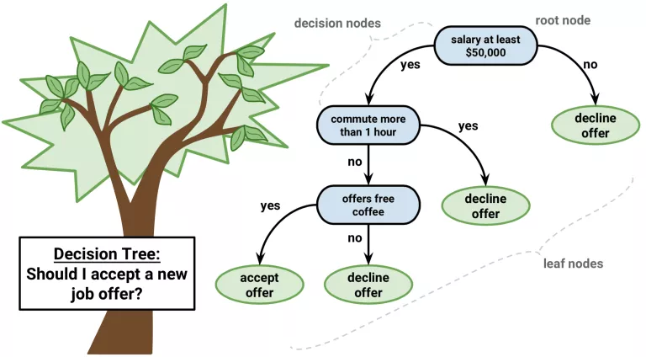
WORKING OF DECISION TREE
Place the best attribute of the dataset at the root of the tree.
Split the training set into subsets. Subsets should be made in
such a way that each subset contains data with the same value for an attribute.
Repeat step 1 and step 2 on each subset until you find leaf nodes in all the branches of the tree.
In decision trees, for predicting a class label for a record we start from the root of the tree. We compare the values of the root attribute with the record's attribute. On the basis of comparison, we follow the branch corresponding to that value and jump to the next node.
Working of decision tree
Notes:
Image source:-
https://pixabay.com/en/computer-keyboard-apple-laptop-2563737/

Slide 9

APPLICATION OF DECISION TREE
Predicting high occupancy dates for hotels
Identifying factors leading to better gross margins on a retail chain
Identifying correlates to high average checks for a global quick-service restaurant chain
Soybean disease classification – 1979, 97% accuracy vs. 72% by human expert
Classification system for serial criminal patterns (CSSCP) using three years' worth of data on armed robbery, the system was able to spot 10 times as many patterns as a team of experienced detectives with access to the same data.
Screening potential terrorists and drug smugglers at border crossings
Notes:
Image source:-
https://pixabay.com/en/computer-keyboard-apple-laptop-2563737/

Slide 10
ADVANTAGES AND DISADVANTAGES
Advantages
Decision trees generate understandable rules.
Decision trees perform classification without requiring much computation.
Decision trees are capable of handling both continuous and categorical variables.
Disadvantages
Decision trees are less appropriate for estimation tasks where the goal is to predict the value of a continuous attribute.
Decision trees are prone to errors in classification problems with many class and a relatively small number of training examples.
Notes:
Image source:-
https://pixabay.com/en/computer-keyboard-apple-laptop-2563737/

Slide 11
03
NAÏVE BAYES CLASSIFICATION
Notes:
Image source:-
https://pixabay.com/en/architecture-building-business-2179108/

Slide 12
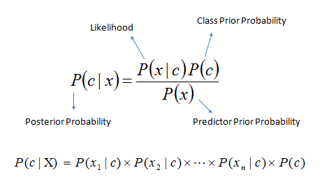
NAÏVE BAYES CLASSIFICATION
Naive Bayes is a simple technique for constructing classifiers, models that assign class labels to problem instances, represented as vectors of feature values, where the class labels are drawn from some finite set.
There is not a single algorithm for training such classifiers, but a family of algorithms based on a common principle: all naive Bayes classifiers assume that the value of a particular feature is independent of the value of any other feature, given the class variable.
For example, a fruit may be considered to be an apple if it is red, round, and about 10 cm in diameter. A naive Bayes classifier considers each of these features to contribute independently to the probability that this fruit is an apple, regardless of any possible correlations between the color, roundness, and diameter features.
Naïve Bayes Classifier
Notes:
Image source:-
https://pixabay.com/en/computer-keyboard-apple-laptop-2563737/

Slide 13
BAYES’ THEORM
Bayes’ Theorem finds the probability of an event occurring given the probability of another event that has already occurred. Bayes’ theorem is stated mathematically as the following equation:
where A and B are events
Basically, we are trying to find probability of event A, given the event B is true. Event B is also termed as evidence.
P(A) is the priori of A (the prior probability, i.e. Probability of event before evidence is seen). The evidence is an attribute value of an unknown instance(here, it is event B).
P(A|B) is a posteriori probability of B, i.e. probability of event after evidence is seen.
Notes:
Image source:-
https://pixabay.com/en/computer-keyboard-apple-laptop-2563737/

Slide 14

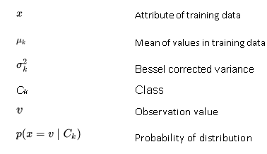
GAUSSIAN NAÏVE BAYES
Gaussian Naïve Bayes implements the Gaussian Naive Bayes algorithm for classification. The likelihood of the features is assumed to be Gaussian:
Notes:
Image source:-
https://pixabay.com/en/computer-keyboard-apple-laptop-2563737/

Slide 15
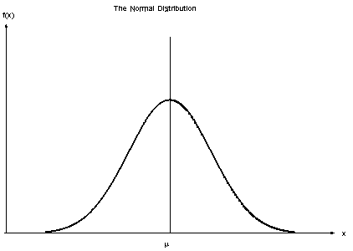
TYPES OF NAÏVE BAYES
Multinomial Naive Bayes
This is mostly used for document classification problem, i.e. whether a document belongs to the category of sports, politics, technology etc. The features/predictors used by the classifier are the frequency of the words present in the document.
Bernoulli Naive Bayes
This is similar to the multinomial naive Bayes but the predictors are Boolean variables. The parameters that we use to predict the class variable take up only values yes or no, for example if a word occurs in the text or not.
Gaussian Naive Bayes
When the predictors take up a continuous value and are not discrete, we assume that these values are sampled from a Gaussian distribution.
Normal Distribution
Notes:
Image source:-
https://pixabay.com/en/computer-keyboard-apple-laptop-2563737/

Slide 16
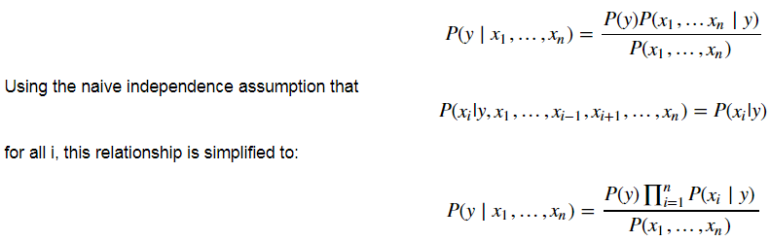
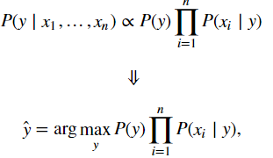
WORKING OF NAÏVE BAYES
Naive Bayes methods are a set of supervised learning algorithms based on applying Bayes’ theorem with the naive assumption of independence between every pair of features. Given a class variable y and a dependent feature vector x1 through x_{n}, Bayes’ theorem states the following relationship:
Constructing the NB Classifier from the Probability model:
So far we have derived the independent feature model, that is, the Naive Bayes probability model. The Naive Bayes classifier combines this model with a decision rule; this decision rule will decide which hypothesis is most probable. Picking the hypothesis that is most probable is known as the maximum a posteriori or MAP decision rule. The corresponding classifier, a Bayes classifier, is the function that assigns a class label to y as follows:
Since P(x1, …, xn) is constant given the input, we can use the following classification rule:
There are different naive Bayes classifiers that differ mainly by the assumptions they make regarding the distribution of P(xi | y). When dealing with continuous data, a typical assumption is that the continuous values associated with each class are distributed according to a Gaussian distribution. So we will use the Gaussian Naïve Bayes.
We now have a relationship between the target and the features using Bayes Theorem along with a Naive Assumption that all features are independent.
We can use Maximum A Posteriori (MAP) estimation to estimate P(y) and P(xi | y); the former is then the relative frequency of class y in the training set.
Notes:
Image source:-
https://pixabay.com/en/computer-keyboard-apple-laptop-2563737/

Slide 17
APPLICATION OF NAÏVE BAYES
Real-time Prediction: As Naive Bayes is super fast, it can be used for making predictions in real time.
Multi-class Prediction: This algorithm can predict the posterior probability of multiple classes of the target variable.
Text classification/ Spam Filtering/ Sentiment Analysis: Naive Bayes classifiers are mostly used in text classification (due to their better results in multi-class problems and independence rule) have a higher success rate as compared to other algorithms. As a result, it is widely used in Spam filtering (identify spam e-mail) and Sentiment Analysis (in social media analysis, to identify positive and negative customer sentiments)
Recommendation System: Naive Bayes Classifier along with algorithms like Collaborative Filtering makes a Recommendation System that uses machine learning and data mining techniques to filter unseen information and predict whether a user would like a given resource or not.
Notes:
Image source:-
https://pixabay.com/en/computer-keyboard-apple-laptop-2563737/

Slide 18
ADVANTAGES AND DISADVANTAGES
Advantages
When assumption of independent predictors holds true, a Naive Bayes classifier performs better as compared to other models.
Naive Bayes requires a small amount of training data to estimate the test data. So, the training period is less.
Disadvantages
Main imitation of Naive Bayes is the assumption of independent predictors. Naive Bayes implicitly assumes that all the attributes are mutually independent. In real life, it is almost impossible that we get a set of predictors which are completely independent.
If categorical variable has a category in test data set, which was not observed in training data set, then model will assign a 0 (zero) probability and will be unable to make a prediction. This is often known as Zero Frequency.
Notes:
Image source:-
https://pixabay.com/en/computer-keyboard-apple-laptop-2563737/

Slide 19
04
RESULT
Notes:
Image source:-
https://pixabay.com/en/architecture-building-business-2179108/

Slide 20
EVALUATION METRICS FOR DECISION TREE
Decision Tree Measures | Train-Test ratio 1 | Train-Test ratio 2 | Train-Test ratio 3
Specificity | 99.4535519125683 | 100.0 | 100.0
Sensitivity | 99.56331877729258 | 99.34640522875817 | 99.34640522875817
Accuracy | 99.51456310679612 | 99.63636363636364 | 100.0
Precision | 2.0 | 1.0 | 1.0
FPR | 183.0 | nan | nan
FNR | 1.0043859649122806 | 1.006578947368421 | 0.0
NPV | 2.0 | 2.0 | 1.0
FDR | 229.0 | nan | nan
MCC | 99.01687068986088 | 99.2666665488999 | 100.0
From the observation, we can conclude that Accuracy of the model is highest and constant throughout our testing of dataset on all train-test ratio
Notes:
Image source:-
https://pixabay.com/en/computer-keyboard-apple-laptop-2563737/

Slide 21
EVALUATION METRICS FOR BOTH MODELS
Naïve Bayes Measures | Train-Test ratio 1 | Train-Test ratio 2 | Train-Test ratio 3
Specificity | 81.97674418604652 | 83.17757009345794 | 80.0
Sensitivity | 86.66666666666667 | 88.09523809523809 | 85.8974358974359
Accuracy | 84.70873786407766 | 86.18181818181819 | 83.33333333333334
Precision | 32.0 | 19.0 | 13.0
FPR | 142.0 | 90.0 | 49.0
FNR | 32.15384615384615 | 20.135135135135137 | 11.164179104477611
NPV | 33.0 | 21.0 | 12.0
FDR | 209.0 | 149.0 | 68.0
MCC | 68.58777231577207 | 71.04002527659058 | 66.03161074375328
From the observation, we can conclude that Accuracy of the model is lowest and constant throughout our testing of dataset on all train-test ratio
Notes:
Image source:-
https://pixabay.com/en/computer-keyboard-apple-laptop-2563737/

Slide 22
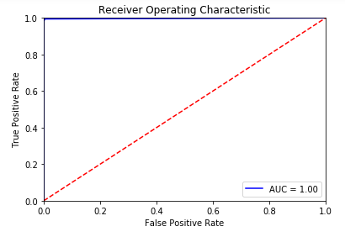
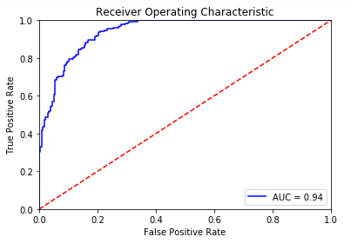
ROC CURVE
This is the ROC curve of Decision Tree Classification
Area under curve is 1.00
The ROC curve is created by plotting the true positive rate against the false positive rate at various threshold settings
This the ROC curve of Naïve Bayes Classification
Area under curve is 0.94
The ROC curve is created by plotting the true positive rate against the false positive rate at various threshold settings
Notes:
Image source:-
https://pixabay.com/en/computer-keyboard-apple-laptop-2563737/

Slide 23
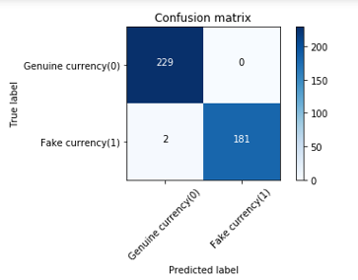
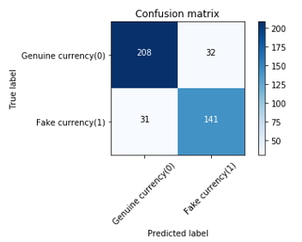
CONFUSION MATRIX
This is the confusion matrix of Decision Tree Classification
Confusion matrix is a matrix of n * n where n is number of classes.
229 is true positive and 0 is false negative
2 is false positive and 181 is true negative
From the above observation, we can calculate Accuracy of model and other parameters of confusion matrix
This is the confusion matrix of Naïve Bayes Classification
Confusion matrix is a matrix of n * n where n is number of classes.
208 is true positive and 32 is false negative
31 is false positive and 141 is true negative
From the above observation, we can calculate Accuracy of model and other parameters of confusion matrix
Notes:
Image source:-
https://pixabay.com/en/computer-keyboard-apple-laptop-2563737/

Slide 24
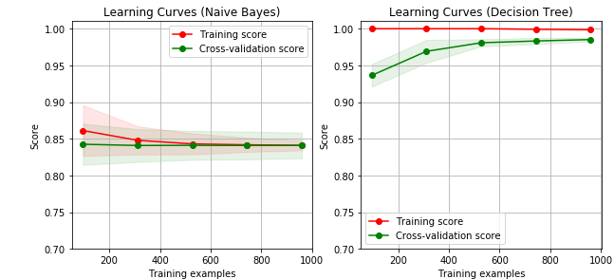
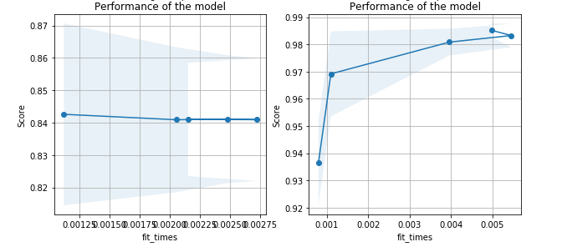
LEARNING CURVE AND PERFORMANCE
This is the learning curve of Decision Tree classification and naïve Bayes classification. From both the graphs we can predict the accuracy of train data and test data on different training data
This is the performance of both the models. In this graph accuracy score of training data is plotted against the Fit_times of training data
Fit_time: The time for fitting the estimator on the train set for each CV split
Notes:
Image source:-
https://pixabay.com/en/computer-keyboard-apple-laptop-2563737/

Slide 25
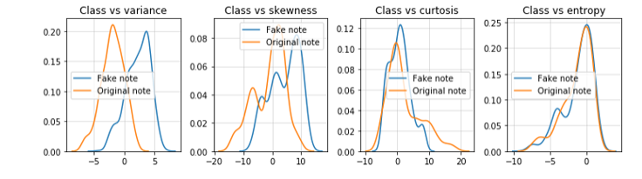
DATA VISUALIZATION OF DECISION TREE
In the above plot comparison has been made between every feature of dataset and a grid plot has been made of fake note (denoted by blue) and original note (denoted by orange).
Grid plot between every feature of dataset
Notes:
Image source:-
https://pixabay.com/en/computer-keyboard-apple-laptop-2563737/

Slide 26
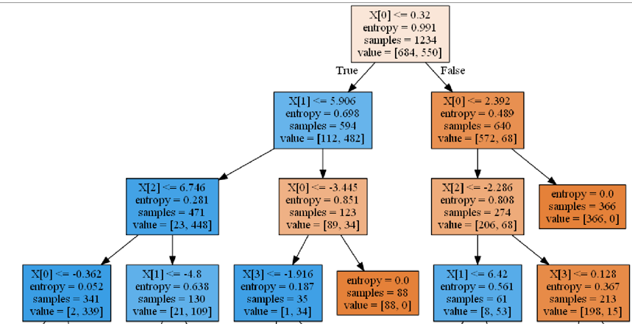
DATA VISUALIZATION OF DECISION TREE
This is a decision tree model of our dataset. In this tree in each node criterion “entropy”, samples and value of each variable is calculated
Criterion is a function, which measures the purity of nodes. Supported criteria are “Gini” for the Gini impurity and “entropy” for the information gain.
Lower the “entropy”, higher the homogeneity of nodes
Decision Tree of our model
Notes:
Image source:-
https://pixabay.com/en/computer-keyboard-apple-laptop-2563737/

Slide 27
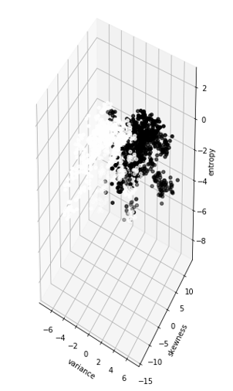
DATA VISUALIZATION OF NAÏVE BAYES
This is a 3-D scatter plot between variance, skewness and entropy. This scatter plot is plotted based on target variable, which is “class”.
Black points in this plot denotes genuine notes and White points in this plot denotes Fake notes
3-D Scatter plot between variance, skewness and entropy
Notes:
Image source:-
https://pixabay.com/en/computer-keyboard-apple-laptop-2563737/

Slide 28

THANK YOU
Notes:
Image source:-
https://pixabay.com/en/coding-programming-working-macbook-924920/

